Slide 1

PeoplePlus
Team BlueHats
Manmeet Singh
Jeyasri Subramanian
Subarna Chowdhury Soma

Slide 2
Key Achievements
3 Different User Roles: HR Specialist, Manager, Employee
Open Source Integration:
- Moodle (LMS) : Moodle_37_github
- KeyCloak : Keycloak_github
- Jenkins
SSO : KeyCloak
Every module runs in different EC2 instance
Deployment on AWS
Test Cases
2

Slide 3








High-level Architecture
View Employees
Role Based Access
manager
PeoplePlusService
View profile
DB
employees
HR
Frontend
WebApp
HR
CRUD Employees
View all Departments
Training Service
Manager
SSO
DB
DB
Employee

Slide 4
User Roles
Manager
View all employees who belong to his department
Can view employee’s details such as salary, title, hire date
HR Specialist
Can view all departments
Can view all employees in all departments
Can terminate an employee
Can edit the employee on title and salary
Create and can assign courses
Has all Site Administration access
Employee
View employee information

Slide 5
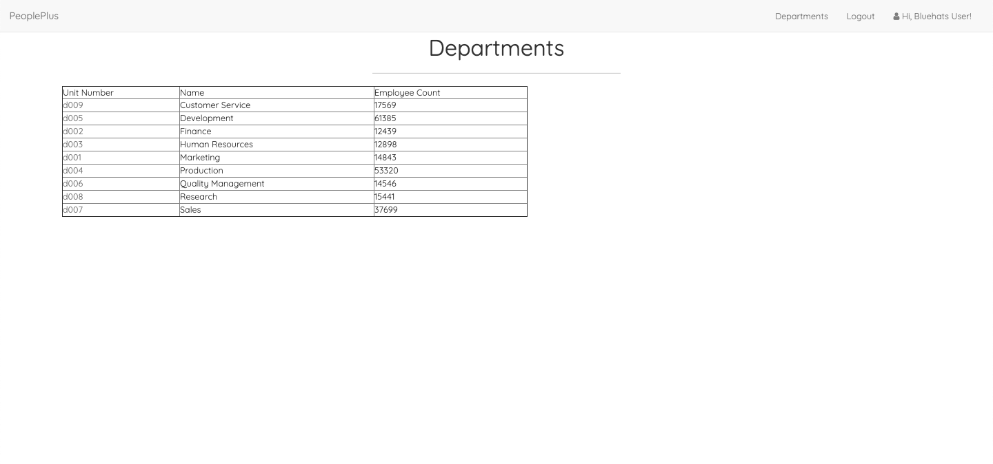
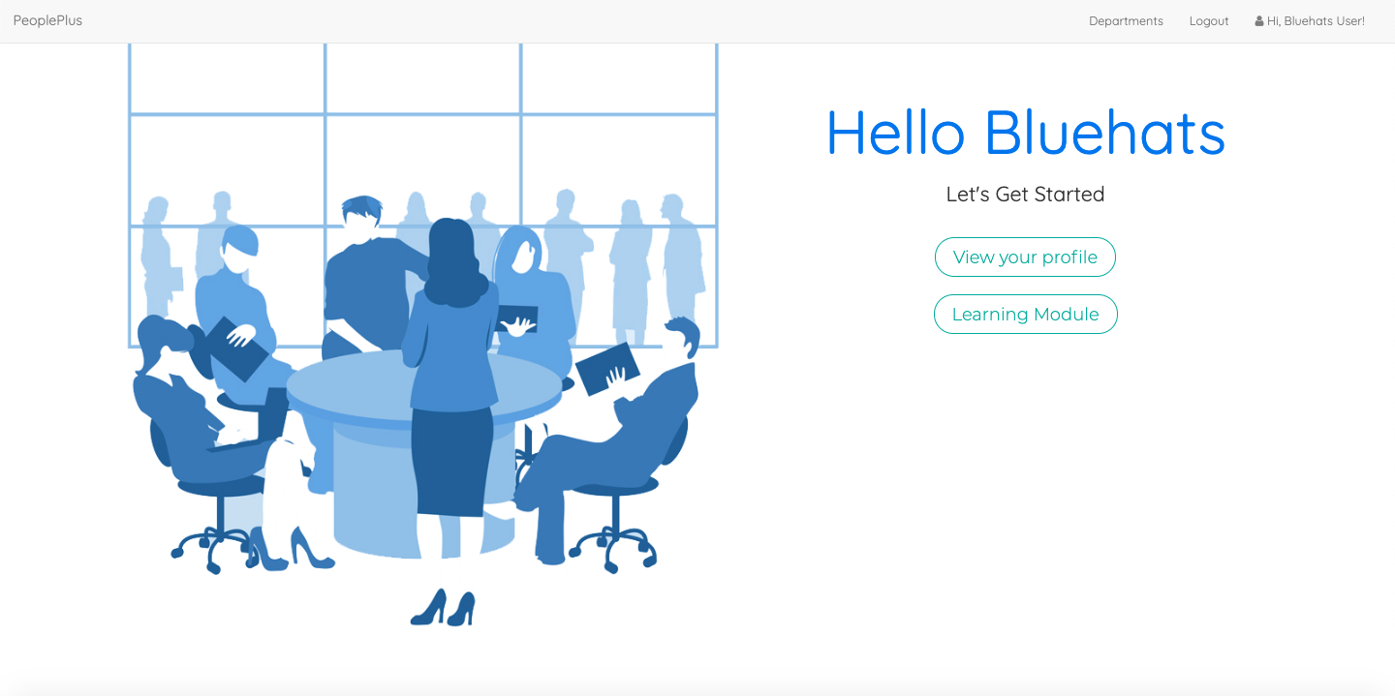
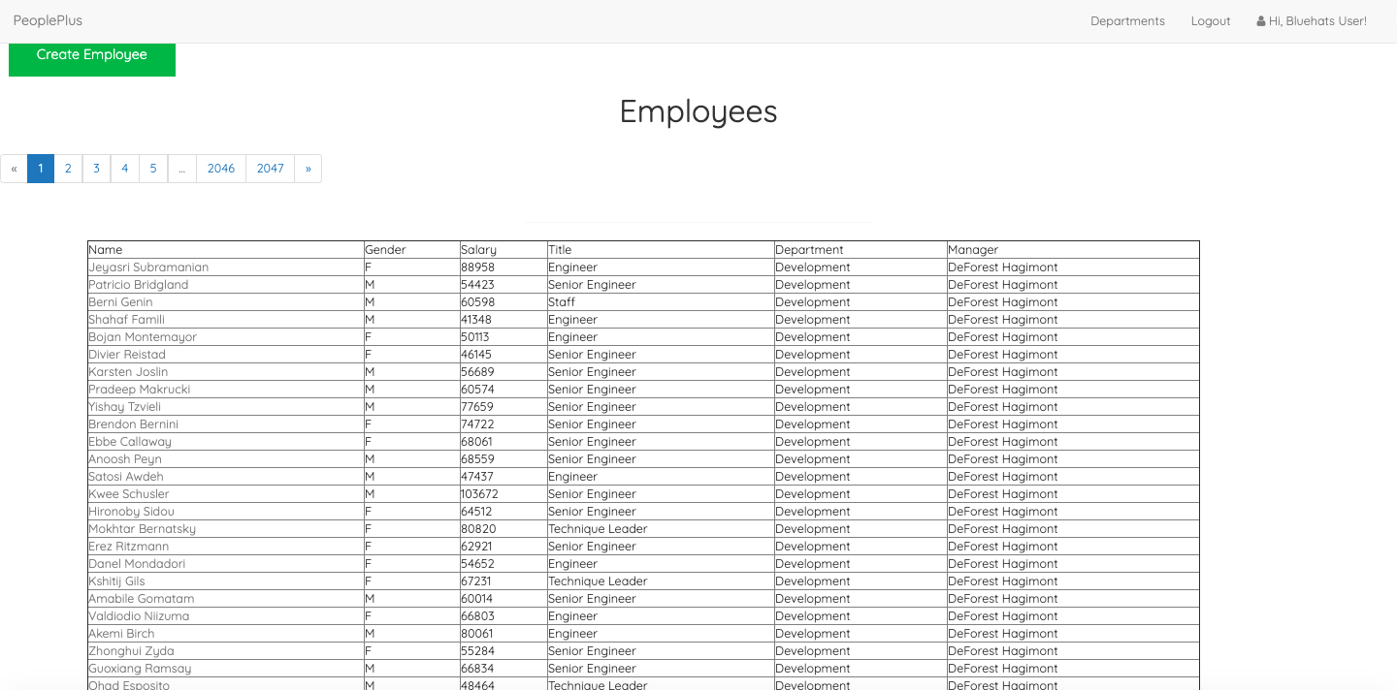
Role: HR

Slide 6
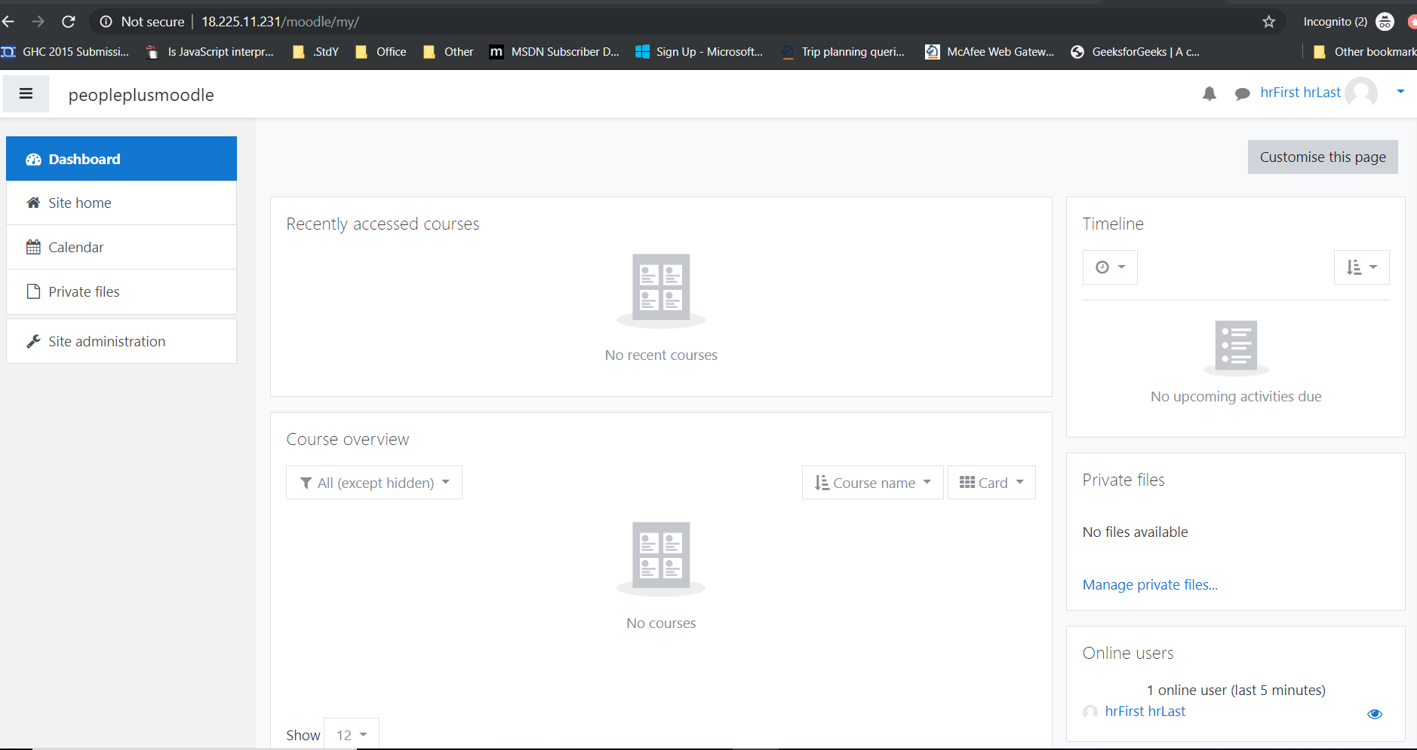

Slide 7
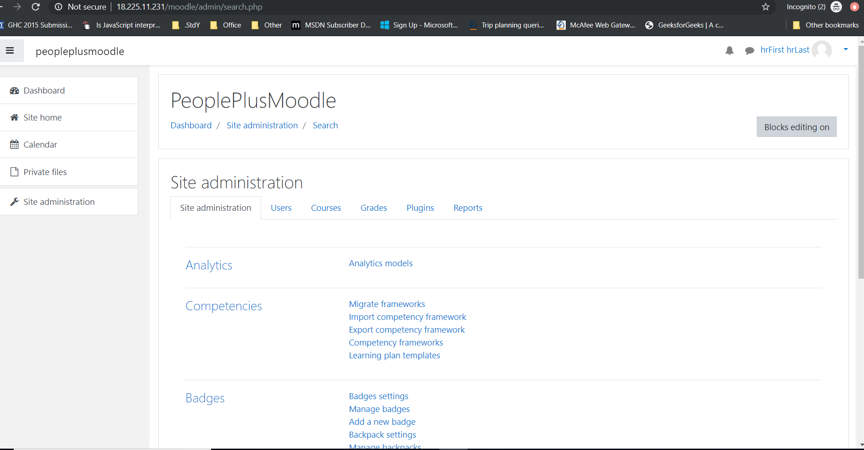

Slide 8
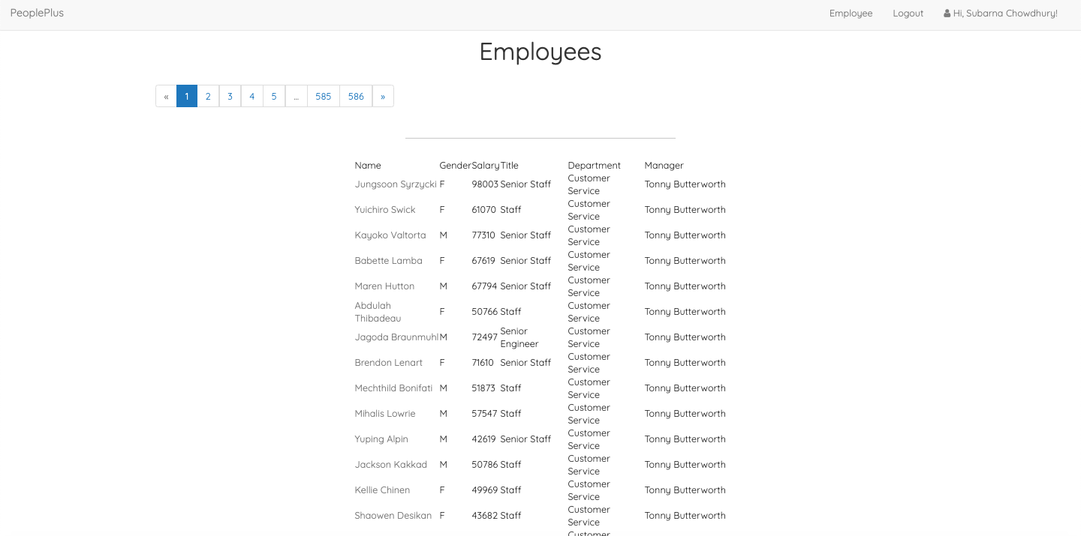

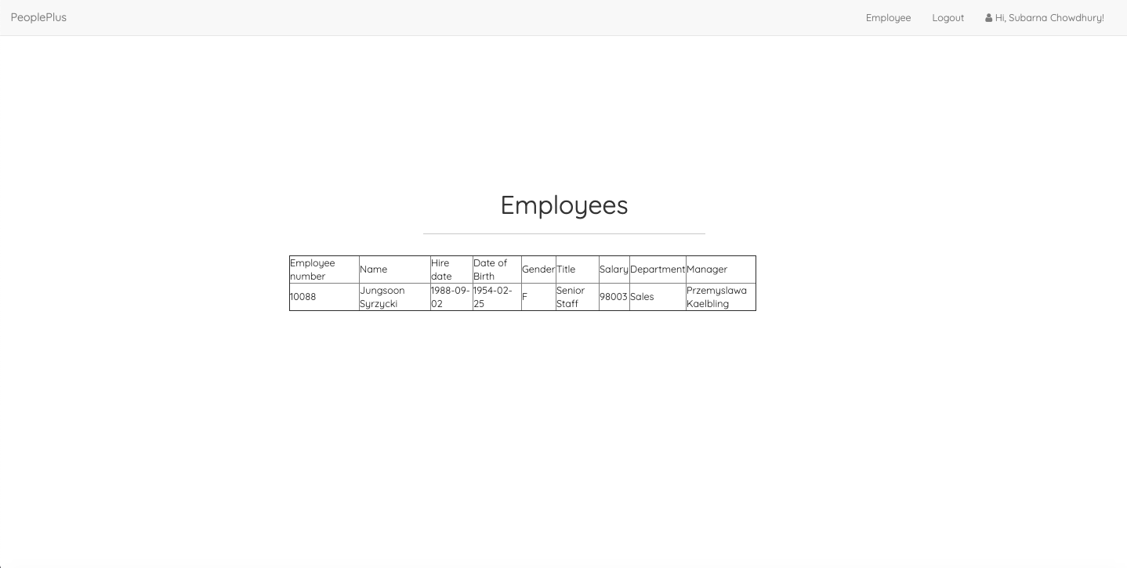
Role: Manager

Slide 9
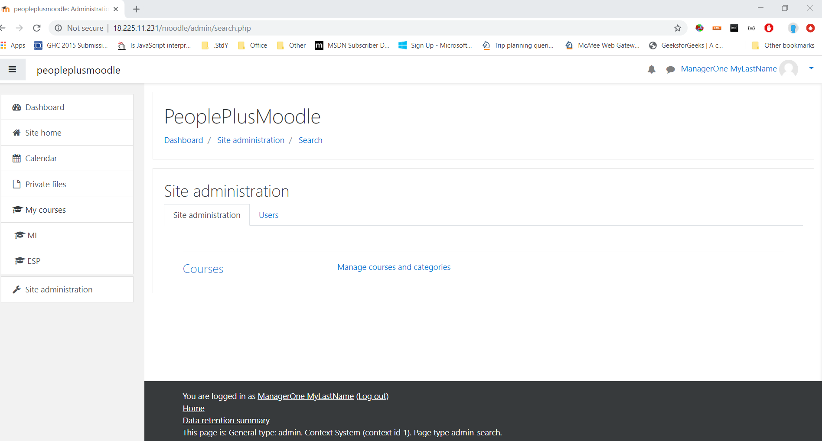

Slide 10
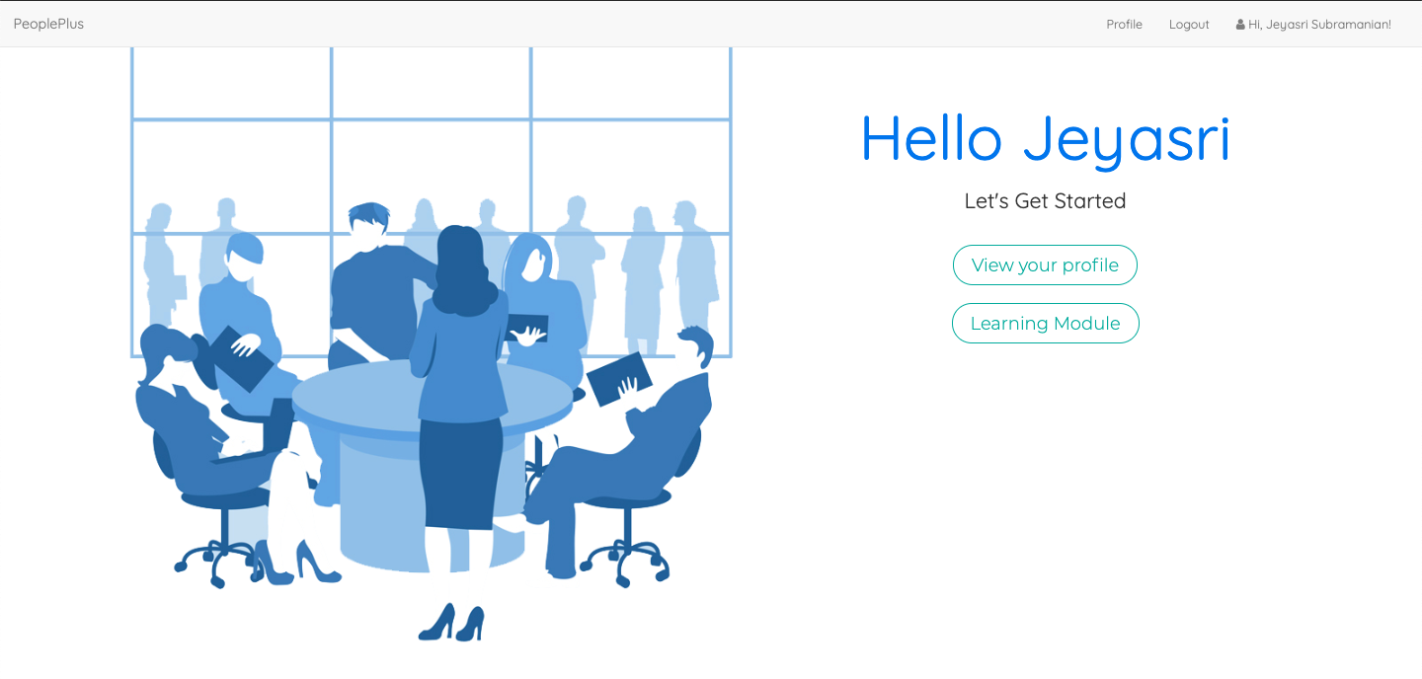
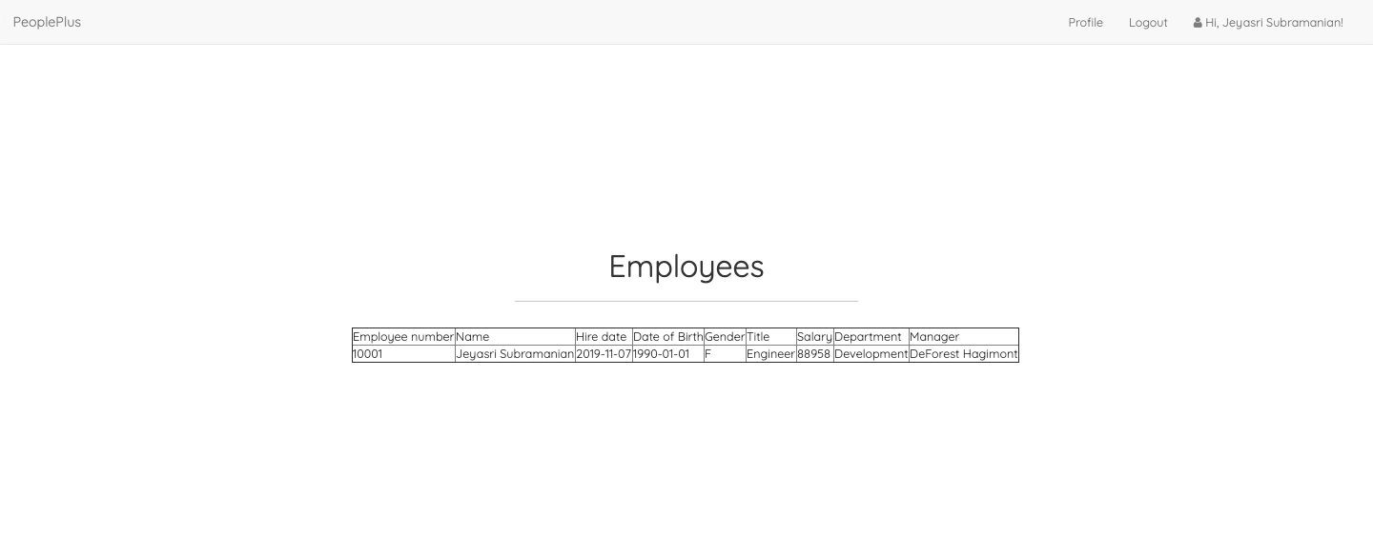
Role: Employee

Slide 11








Tools and Deployment

Slide 12
DEMO

Slide 13
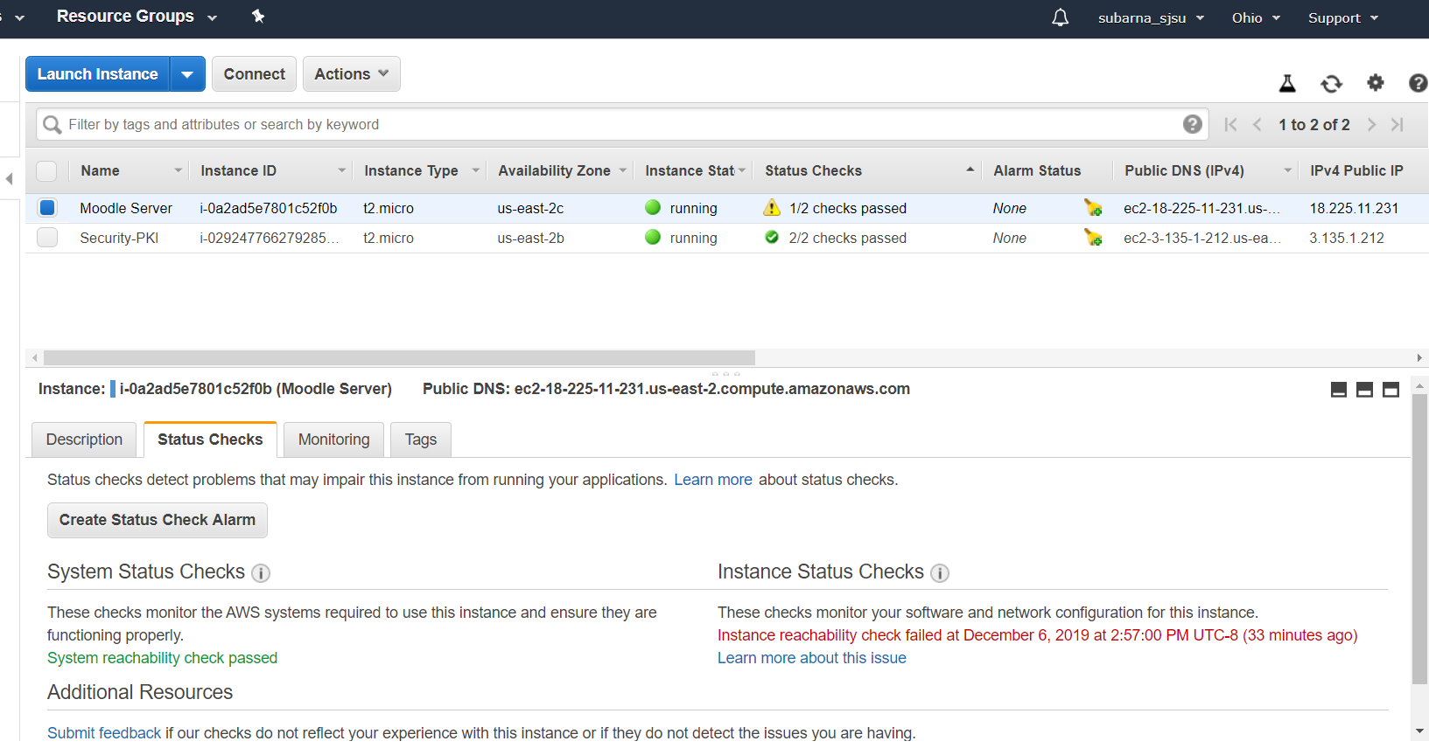

Slide 14

THANKS

Slide 15
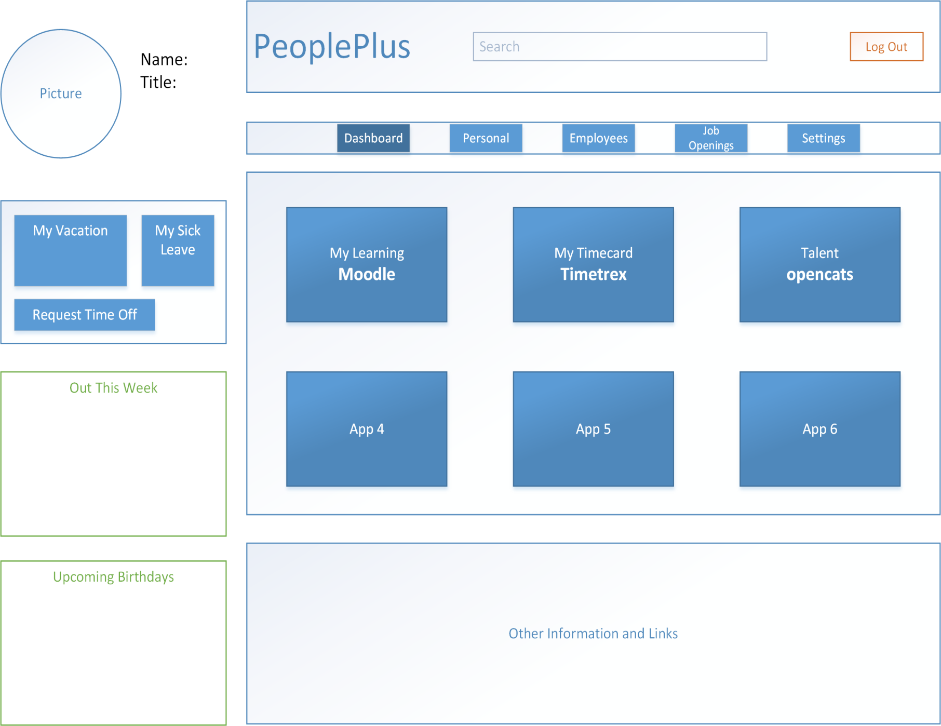
BACKUP
Dashboard Layout
Personalized information in left panel
Control menu in the top navigation bar
Application Menu in the middle
Other resources and contact
information at the bottom

Slide 16
Key Achievements
A Human Resources Management Platform
Improve working efficiency in an organization of any size
3 User Roles: HR Specialist, Manager, Employee
Open Source Integration:
- Moodle (LMS) : Moodle_37_github
- KeyCloak : Keycloak_github
SSO : KeyCloak
Deployment on AWS
16

Slide 17
User Roles
Manager
View HR information for any employees falling under their organization matrix.
Request for an employee to be hired/terminated,
Give feedback on employee evaluation
Assign new training to their employees
Request for new positions to be opened up within their organization.
HR Specialist
Approve or deny any action initiated by a Manager,
Cannot initiate new actions outside their privilege level.
Employee
View yearly evaluation
Complete assigned training
View payroll information

Slide 18
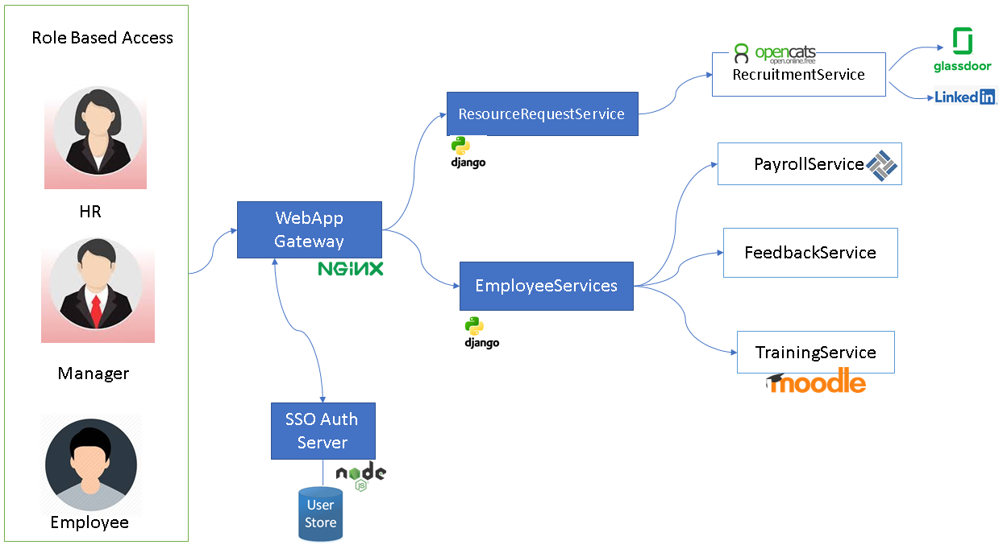
High-level Architecture

Slide 19






Role Based Access
RecruitmentService
ResourceRequestService
PayrollService
DB
HR
Frontend
WebApp
FeedbackService
EmployeeService
TrainingService
Manager
SSO
Employee

